Slide 1

Y-DATA: Yandex School of Data Analysis — 2021
Ensemble Learning
Lior Sidi & Noa Lubin

Slide 2
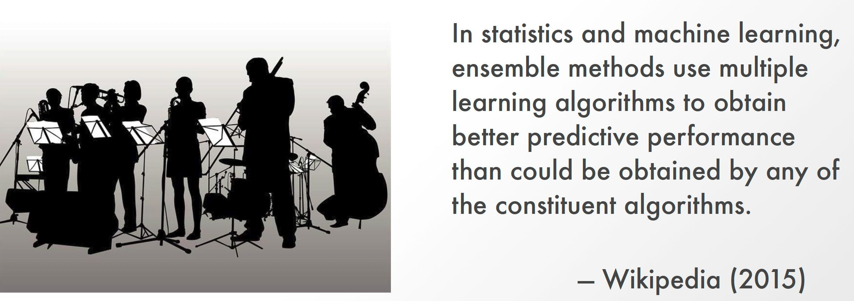
Ensemble Learning?
https://www.slideshare.net/TedXiao/winning-kaggle-101-introduction-to-stacking
Notes:
The concept of ensemble learning is a concept in statistics, where we can take multiple estimators, combine them somehow to create a better performing classifier. (as opposed to a single classifere

Slide 3

Condorcet's Jury Theorem (1785) as Motivation
Given N juries
Probability of jury to make right decision is p > 0.5
What is the probability q of majority decision being correct?
Essay on the Application of Analysis to the Probability of Majority Decisions, Marquis de Condorcet. 1785
Notes:
IT was proven that if you have several voters, that are perfor….. The proibbaility of the group making a decision is higher than one person making a decision.

Slide 4
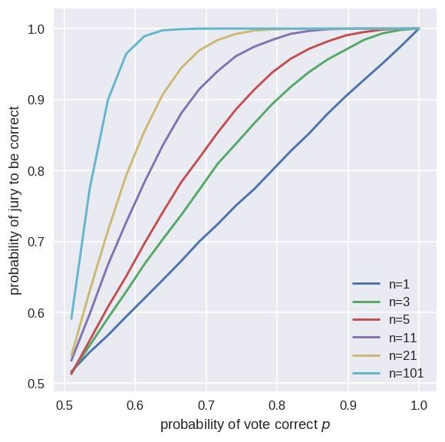
Condorcet's Jury Theorem (1785)
Assume odd independent voters with probability higher than chance probability of being correct.
The probability jury majority is correct is higher than each voter and is increasing and asymptotically reaches 1.
Notes:
As you add more voters to a decision, assuming they each have a competence which is above random, and each is independent, the results are as shown above.

Slide 5
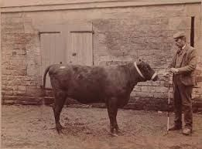
Wisdom of the Crowd
Francis Galton 1906 livestock fair
Guess the ox weights (1198 ponds)
~800 submitted their guess
Nobody was correct
But their average was 1197 pounds!

Slide 6
Back to our models
Robust to Overfitting - Ensemble may not perform like the best train classifier but more likely to be robust and stable for unseen samples
Big data - More suitable for ensembles that can divide the computation
Small data - The sampling technique can uncover and understand better data distribution

Slide 7
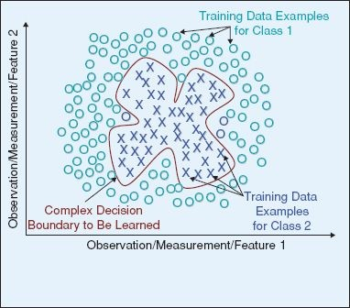
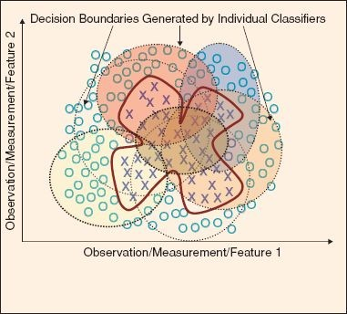

Slide 8



Key elements in ensemble learning
Diversity
Each person should have private information and interpretations.
Independence
People's opinions aren't determined by the opinions of those around them.
Aggregation
Some mechanism exists for turning private judgments into a collective decision.
Notes:
There are three main elements to focus on in ensemble learning, which construct an ensemble model:
Diversity–
Independence– Each classifier is not influenced too much by the other classifiers (like earlier, each voter had their own independent capabilities).
Aggregation– An aggregation function to aggregate the results of the models (average, majority,

Slide 9
Diversity of opinion
Manipulate the estimator
Manipulate the training data
Manipulate the label representation
Partition the search space - Each estimator is trained on a different search subspace.

Slide 10

Measuring the Diversity
Pairwise agreement measures between estimators predictions such as kappa-statistic.
Non-pairwise agreement measures using all estimators predictions such as entropy or correlation of each estimator with the averaged output.

Slide 11
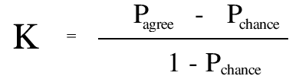
Cohen's Kappa Statistics
P_agree - proportion of instances agreed by the classifiers
P_chance - proportion of instances that agreed by chance
Classifier 1
 | no | yes
no | 33 | 20
yes | 13 | 40
Classifier 2
P_agree = 73 / 106
P_chance = P(class=yes|classifier=1)*P(yes|2) + P(no|1)*P(no|2) = (60/106)*(53/106) + (46/106)*(53/106)

Slide 12
Dependency
Independent Methods
Each estimator is train separately
Seperate data, features, labels.
Dependent Methods:
Model-guided Instance Selection: the estimators from the previous training iterations selects the training set for the next iteration.
Incremental Batch Learning: the estimators predictions serve as a feature for the next training iteration.

Slide 13
Aggregation - Output combination
Majority Voting
Performance weighting
Learn how to aggregate it

Slide 14



Bagging
Random Forest
Decorate
Ensemble Methods
Boosting
AdaBoost
Gradient Boosting
Stacking
Mixture of experts
Stacking
Notes:
Bagging– bootstrap aggregation

Slide 15
Bagging
Bootstrap Aggregating

Slide 16
Bagging - main concepts
Dependency - Same type of estimators.
Aggregate - Voting or averaging with equal weight
Diversify - subset of dataset based on features, sampling and/or labels
Model Flow:
Sample training sets of size n
Fit an estimator for each training set
Combine the classifier’s predictions
Notes:
Equal weight for all of the classifiers.

Slide 17
Bagging Variants
Pasting
When random subsets of the dataset are drawn as random subsets of the samples
L. Breiman, Pasting small votes for classification in large databases and on-line, 1999
Bagging
When random samples of the dataset are drawn with replacement
L. Breiman, Bagging predictors, 1996
Random Subspaces
When random subsets of the dataset are drawn as random subsets of attributes
T. Ho, The random subspace method for constructing decision forests, 1998
Random Patches
When base estimators are built on subsets of both samples and attributes
G. Louppe and P. Geurts, Ensemble on random patches, 2012
Random Forests
A hybrid of Bagging and Random Subspaces, uses Decision Trees as the base classifier with random splits
L. Breiman, Random Forests, 2001

Slide 18
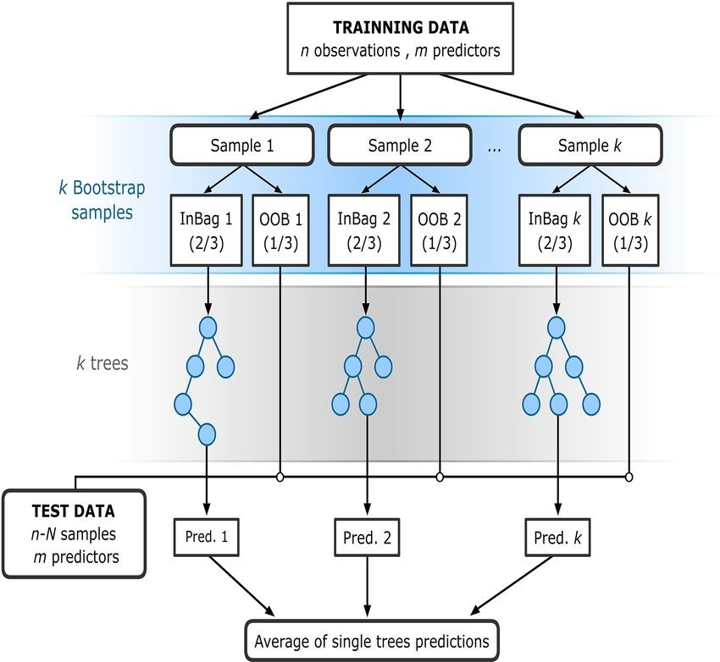
Random Forest Trees Bagging
Bootstrap sampling
DT
Bootstrap aggregating
aggregating functions e.g. Majority voting for classification, Average for regression over the single tree predictions
https://www.analyticsvidhya.com/blog/2020/12/out-of-bag-oob-score-in-the-random-forest-algorithm/
Notes:
We sample the data
We classify (here, using decision tree)
We aggregate.

Slide 19
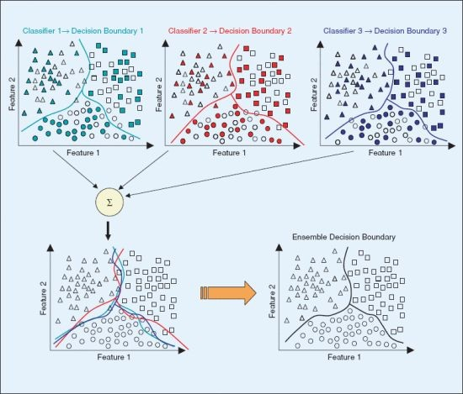

Slide 20
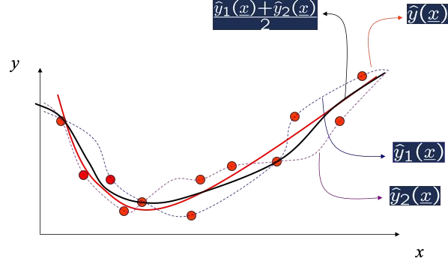
Bagging behavior simulation
Notes:
Red line is the true label, black is the average.

Slide 21
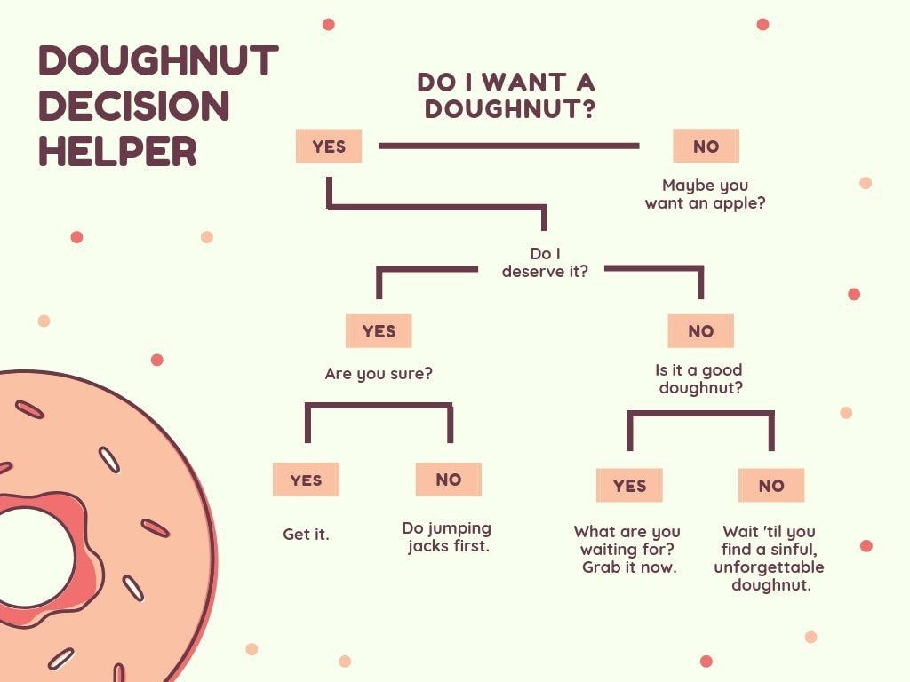
Why Decision Trees?
Easy to understand
Non-linear
Fast train and predict
Apply feature selection
Robust to skewed features

Slide 22
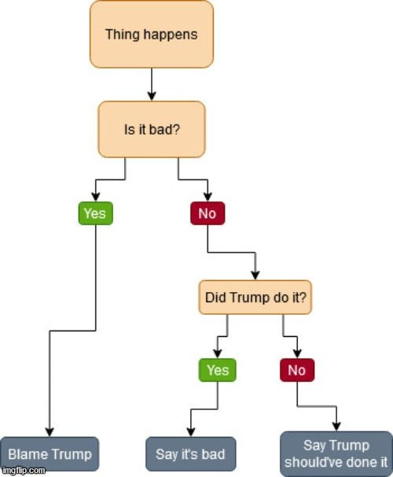
Why Not Decision Trees?
Tends to Over fitting
Decision boundaries are rectilinear
Problem handling unbalanced classes
Problem handling missing/new data
Uses a greedy approach and can get stuck in local minimum
Time consuming splitting on features with continuous values

Slide 23
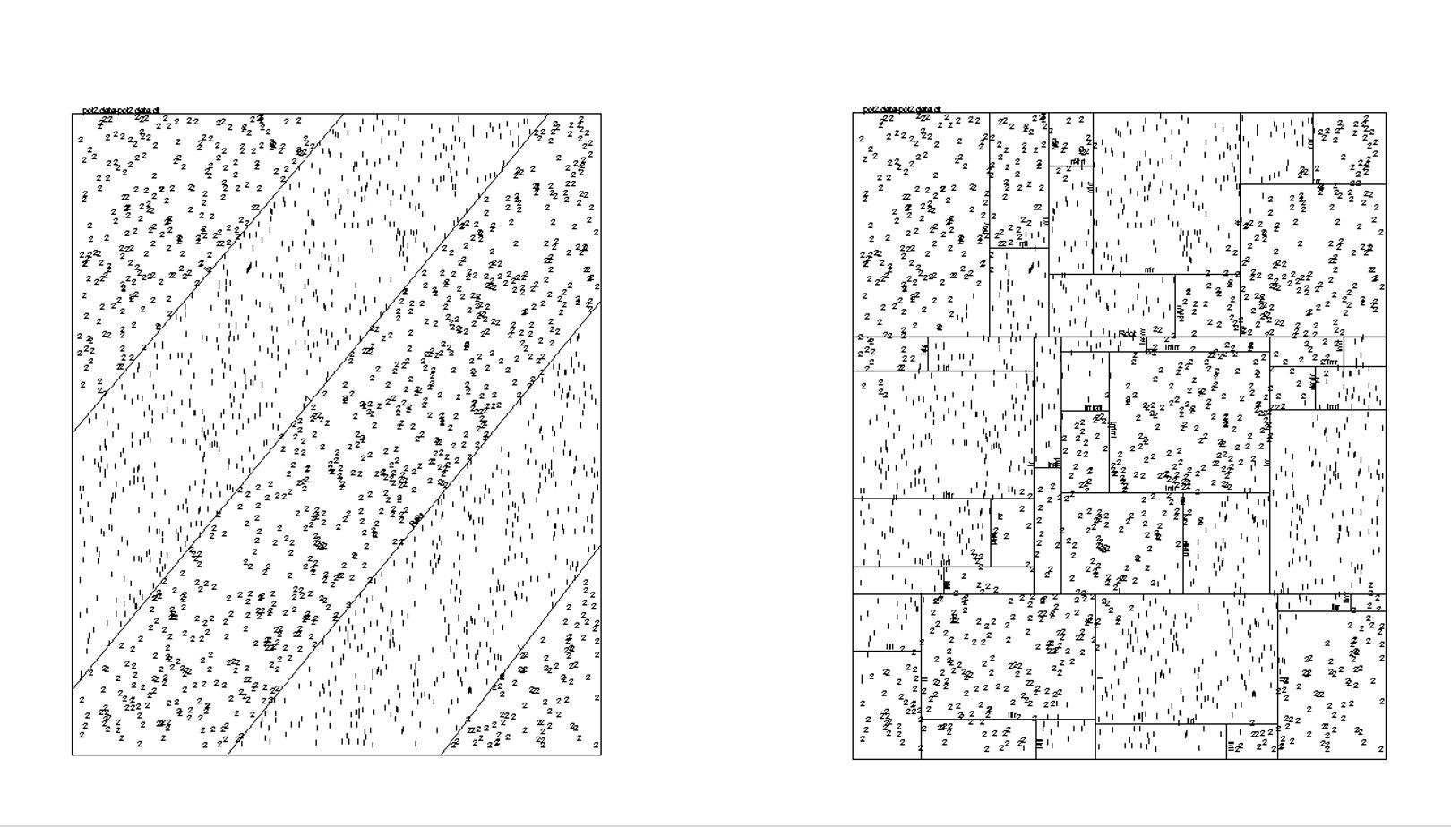

Slide 24
Rotation Forest
Rotation forest transforms the data set while preserving all information
PCA is used to transform the data
subset of the instances
subset of the classes
subset of the features: low computation, low storage
Rodriguez, Juan José, Ludmila I. Kuncheva, and Carlos J. Alonso. "Rotation forest: A new classifier ensemble method." IEEE transactions on pattern analysis and machine intelligence 28.10 (2006): 1619-1630.

Slide 25
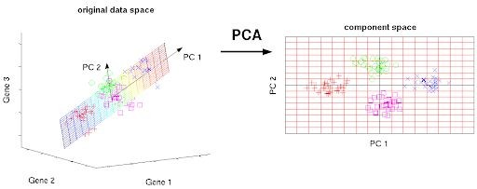
Principal Components Analysis
PCA projects the data along the directions where the data varies the most.

Slide 26
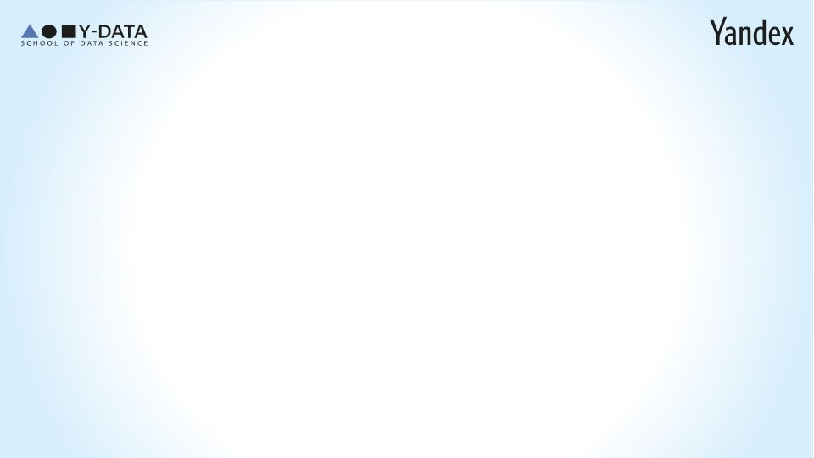
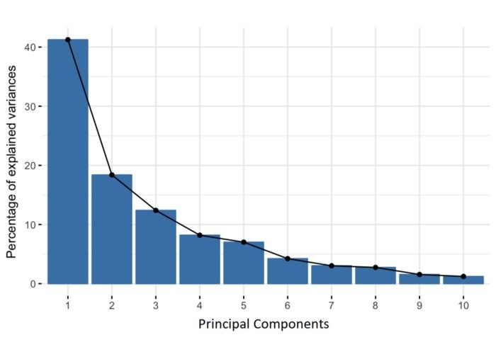
Principal Components Analysis
Principal components are constructed as linear combinations which are uncorrelated and most of the information is compressed into the first components.
https://builtin.com/data-science/step-step-explanation-principal-component-analysis

Slide 27
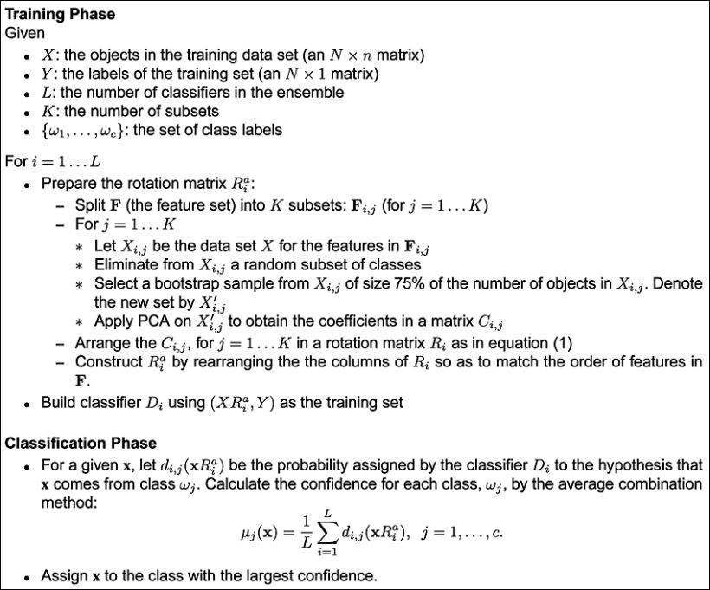

Slide 28
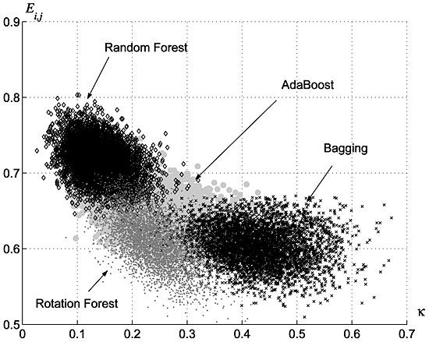
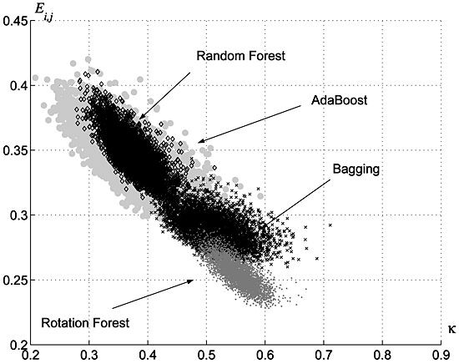
Comparing between ensembles
Average Estimators Error
Estimators Agreement Kappa (k) = Agreement
Rodriguez, Juan José, Ludmila I. Kuncheva, and Carlos J. Alonso. "Rotation forest: A new classifier ensemble method." IEEE transactions on pattern analysis and machine intelligence 28.10 (2006): 1619-1630.
Notes:
High values mean they agree, low values mean they don’t agree.
We see that the rotation forest has low error, and low agreement (between the estimators.

Slide 29


Slide 30
Boosting

Slide 31
What are weak learner and strong learner?
Weak learner
a classifier that is only slightly correlated with the true classification (it can label examples better than random guessing)
Strong learner
a classifier that is arbitrarily well-correlated with the true classification. Hard to train

Slide 32
How Bias & Variance are effected?
Bias
The tendency to consistently learn the same wrong thing because the hypothesis space considered by the learning algorithm does not include sufficient hypotheses
Variance
The tendency to learn random things irrespective of the real signal due to the particular training set used

Slide 33
How Bias & Variance are effected?
Estimator with many parameters (Strong)
Generally low bias
Fits data well
Yields high variance
Estimator with few parameters (Weak)

Slide 34
How Bias & Variance are effected?
Estimator with many parameters (Strong)
Generally low bias
Fits data well
Yields high variance
Estimator with few parameters (Weak)
Generally high bias
May not fit data well
The fit does not change much for different data sets (low variance)

Slide 35
Can we turn a weak learner into a strong learner?
This question was posed by Kearns and Valiant in 1988
Solved in 1990 by Robert Schapire, then a graduate student at MIT “The Strength of Weak Learnability”
(details are beyond the scope of this course)
In 1995, Schapire and Freund proposed AdaBoost:
Turn a set of weak learners (e.g. simple rule of thumbs) into a strong learner

Slide 36
Main Concept
Focus on difficult instances with high error
Iteratively increase weights for high error examples
Combine the results with weighted voting
Notes:
The main concept is that we want to focus on the diffifuclt instance every time.
Iteratively, as we have more mistakes on a specific instance, we want to increase the weights of a certain mechanism.
We then want to have away to combine the weights together

Slide 37
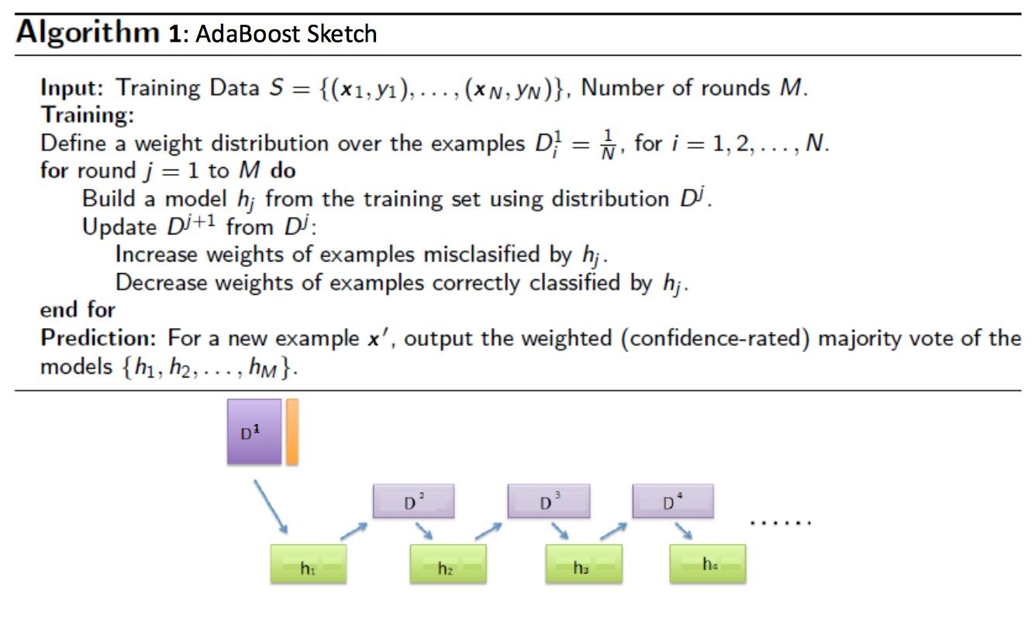
Notes:
We train the first, weak, classifier. Then based on this, we generate a new dataset (which is different, because of the weights of the samples).

Slide 38
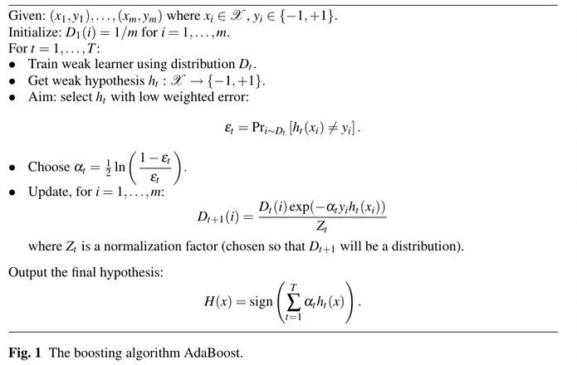
Notes:
Previous slide was the algorithm on the high level. This is more technical:

Slide 39
Weighted error of the j’th model
Notes:
Com,pute a weighted error of the model– more weight to a classifer which was correct a lot. If the model was incorrect all the time,

Slide 40
Weighted error of the j’th model
“Confidence” of the j’th model

Slide 41
Weighted error of the j’th model
“Confidence” of the j’th model
Update weights - after normalization, the probabilities sum to 1
Notes:
The second dataset gets updated– Take the samples which we were mistaken on, and adjust their weights.
The alpha is the step size.

Slide 42
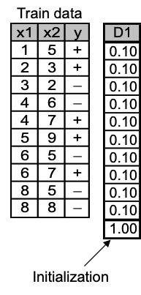
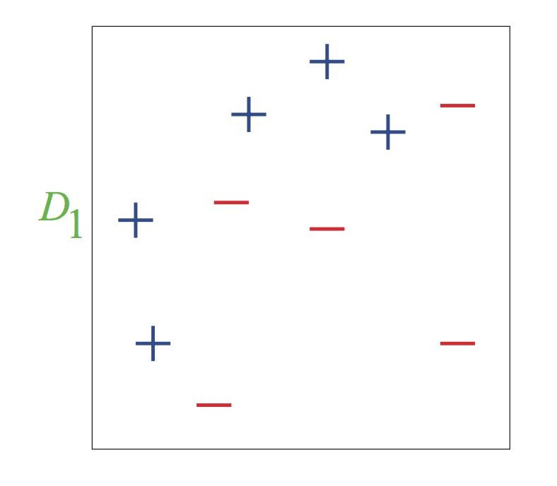
AdaBoost: Toy Example

Slide 43
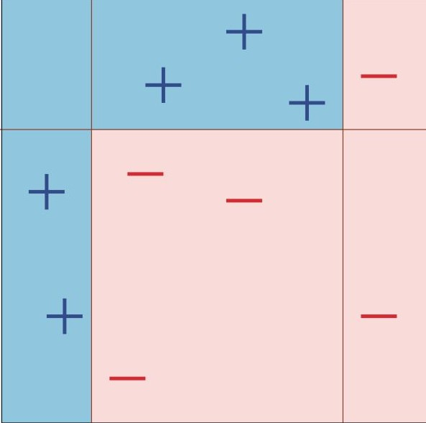


AdaBoost: Toy Example
Notes:
This is a decision tree which we would expect to learn.
Initially, we give the same weight for each of these points.

Slide 44
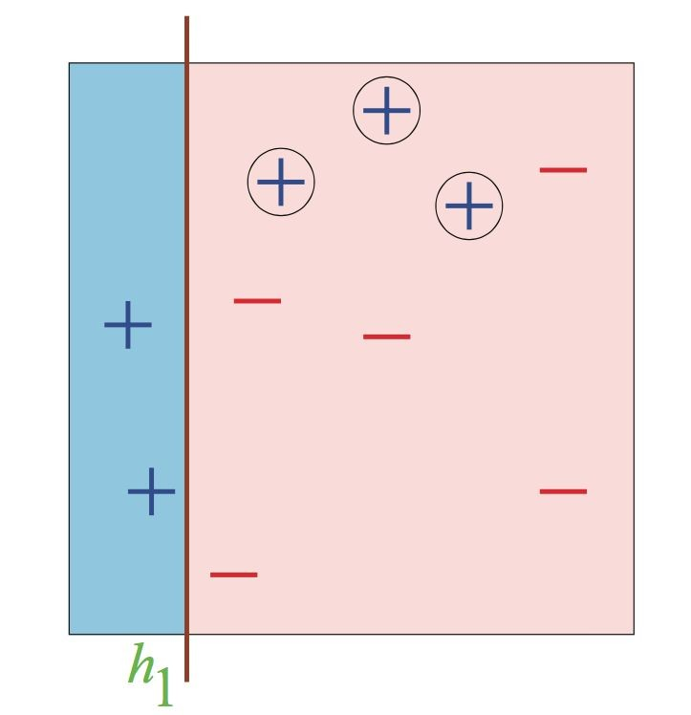
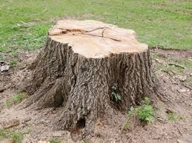
Stump tree
feature
Leaf
Leaf
Notes:
Initially we have just one simple stump tree, splitting based off impurity or information gain.

Slide 45

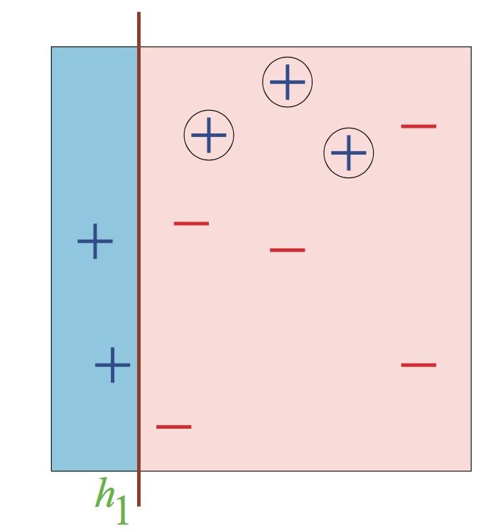

AdaBoost: Toy Example
Notes:
We got our model, and it was mistaken on three points. So we keep their weights of 0.1, and compute the error of the classifier.

Slide 46



AdaBoost: Toy Example
Notes:
We then compute the alpha (how strong is the first classifier that we have), based off this error.

Slide 47
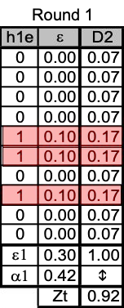
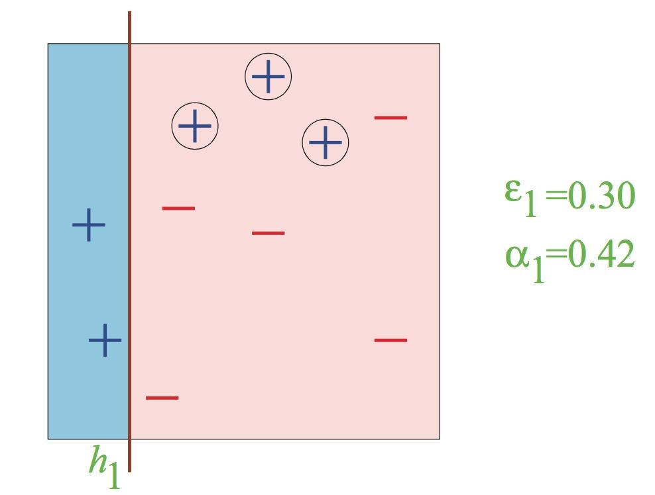
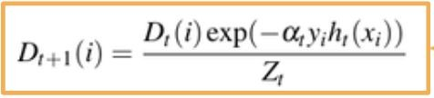
AdaBoost: Toy Example
Notes:
To compute the next data set, we take the previous weights, multiply it with the weights we got, times the y times the prediciton. (0.1 *-0.42 *-.3 / sum of all weights which we now got (=1),

Slide 48
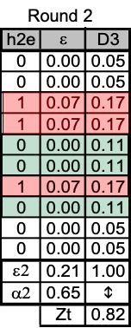
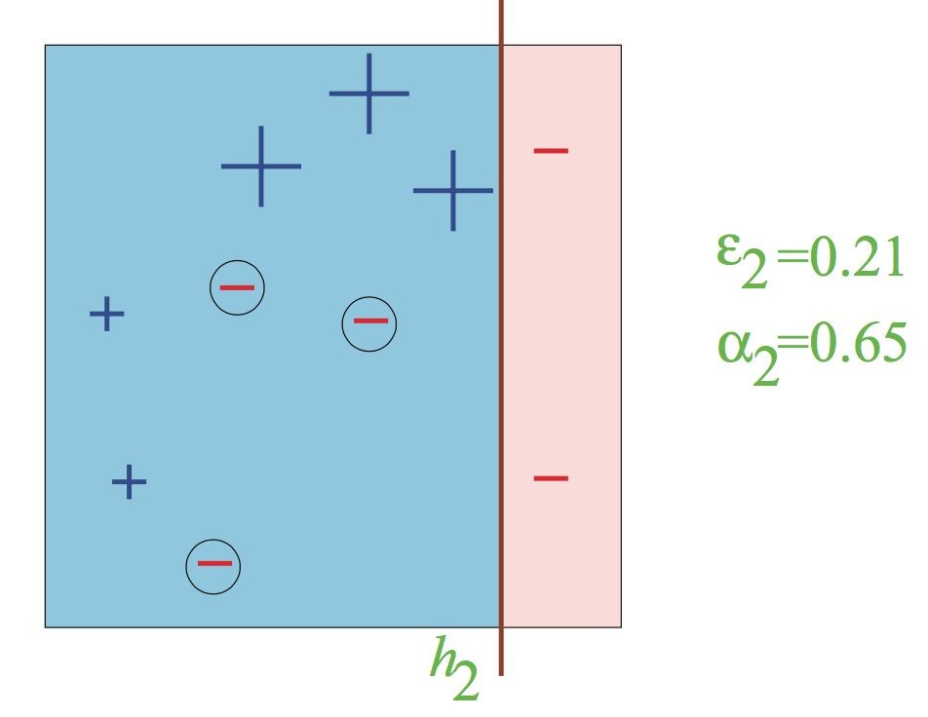

AdaBoost: Toy Example
Notes:
We can se in the next round, that the values which we got wrong are now bigger. Now we have three different mistakes.

Slide 49
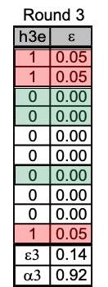
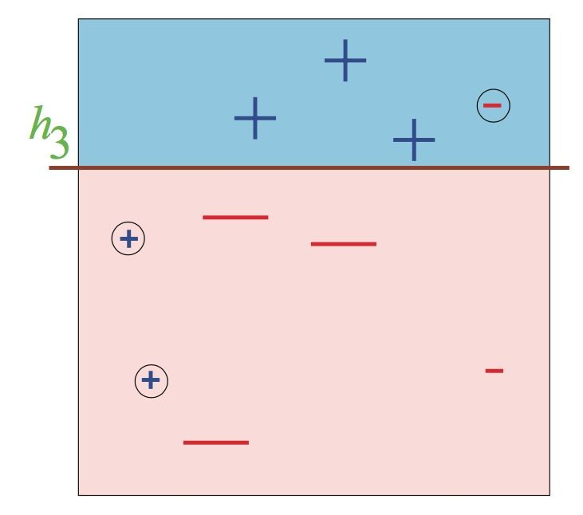
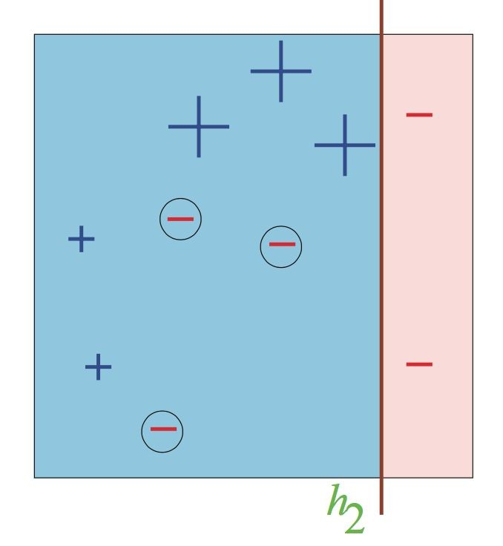
AdaBoost: Toy Example

Slide 50
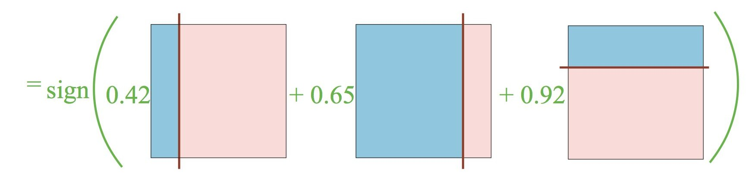
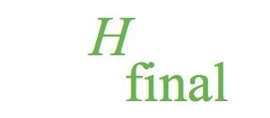
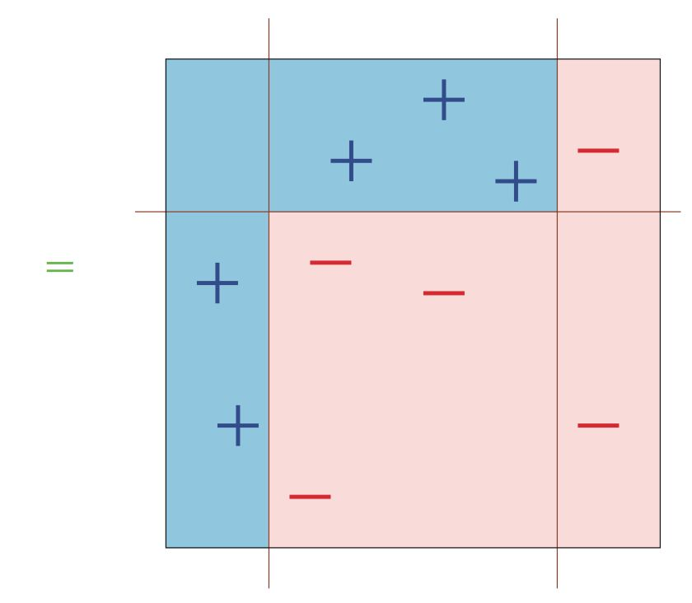
AdaBoost: Toy Example

Slide 51
Intuition about the weights update
The larger the error, the less we trust this classifier and the smaller is its weight
If the error is < 0.5 (just better than random guess), then alpha is positive If not -- just flip the predictions
If the classifier was wrong on a specific example, y * h(x) = -1, and since alpha is positive, the relative weight of misclassified samples will increase while the relative weight of correctly classified samples will decrease
If the error is > 0.5, and we don’t flip, no harm done. Why?
Classifiers with exactly 0.5 error rate add no information, so their weight is 0

Slide 52
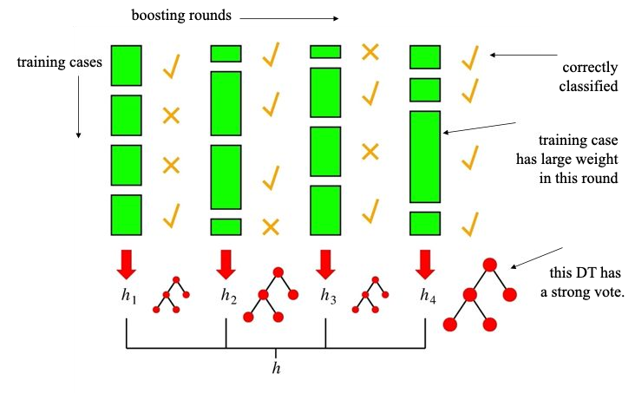

Slide 53
Its empirically shown that:
Bagging: reduce variance.
AdaBoost: reduces both the bias and the variance.
it seems that bias is mostly reduced in early iterations, while variance in later ones.
Bagging behavior simulation

Slide 54
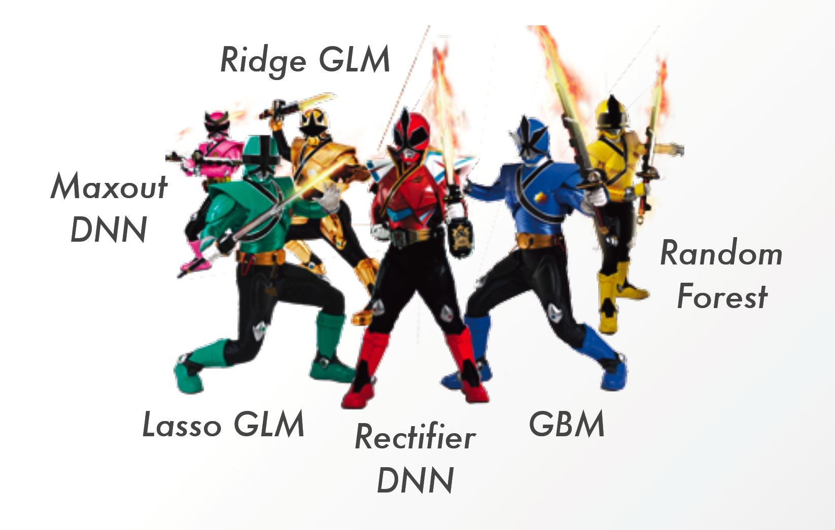
Stacking

Slide 55
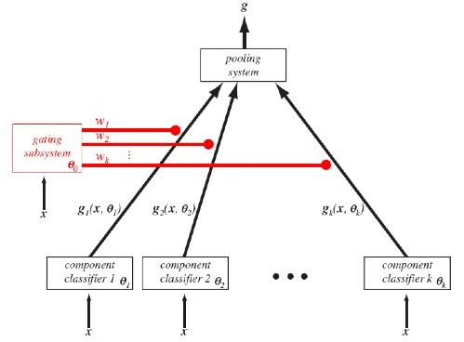
Mixture of experts
Nowlan, S. J. and Hinton, G. E. (1991) Evaluation of Adaptive Mixtures of Competing Experts Advances in Neural Information Processing Systems 3.
Notes:
Instead of using many weak learners, we can combine lots of strong workers.
Different members of a data science team can work on their own models in parallel, and then stack all of their models together.
Best aggregation is using the majority, rather then the weights of the results.
We take the output of all of the independent classifiers (unlike adaboosts dependent), learn a gating function (kind of like logistic regression weights), and combine them together.

Slide 56
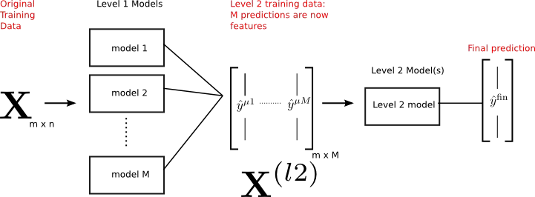
Stacking models
Wolpert, David H. "Stacked generalization." Neural networks5.2 (1992): 241-259.
Notes:
We want this model to be simple, and not overkill it, because all of the logic is in the classifiers themselves.

Slide 57
Is there a Leakage?
Data for ensemble
Fit Model 1
Predict 1
Data
Fit Model 2
Predict 2
Predictions as features
Fit Model 4
Fit Model 3
Predict 3
Notes:
When we train each of the models, we use the same data to train the original models, and the final stacked model. So we have a leakage of the labels to the features, because they are using the same data. In other words, we are training on the training set, and then predicting on the training set again.

Slide 58
Is there a Leakage? Yes
Fit Model 1
Predict 1
Fit Model 2
Predict 2
Predictions as features
Fit Model 4
Data 80%
Fit Model 3
Predict 3
Data 20%
Data for ensemble
Notes:
We hold out 20 percent to train the ensemble itself, to prevent from overfitting from the original model fits.

Slide 59
Improve with context features
Context
Fit Model 1
Predict 1
Fit Model 2
Predict 2
Predictions as features
Fit Model 1
Data 80%
Fit Model 3
Predict 3
Data 20%
Data for ensemble
Notes:
Another best practice is to add a context.
IT could be that prediction 1 is very bad for users from the united states. Meaning, each model might be correct, but in different scenarios.

Slide 60
Behavior Knowledge space
In training:
Fit each classifier separately
For each classification combination count how many times each classifier was correct and save it in a lookup table
In prediction:
Perict each classifier
Use lookup table for prediction combination
Predict with the best model

Slide 61
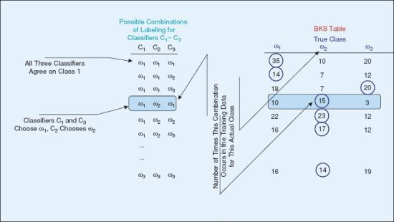
Behavior Knowledge space
Notes:
W1 and w2 and w3 are the classifications. On the right is a lookup table, saying how many times each label was lebeled correctly.

Slide 62
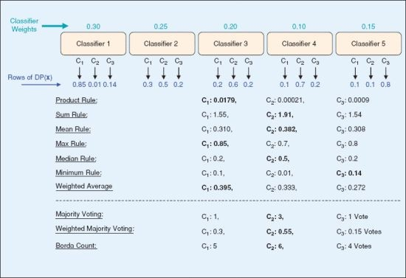

Slide 63
Stacking best practices
Dependency - ?
Aggregate - ?
Diversify - ?

Slide 64
Stacking best practices
Dependency - train different models, separate dataset per level
Aggregate - learn it - the stacked model
Diversify - train on different features or/and labels

Slide 65
Methods Comparison
 | Bagging Random Forest | Boosting AdaBoost | Stacking
Diversity
Dependency
Aggregate
Estimator

Slide 66
Methods Comparison
 | Bagging Random Forest | Boosing AdaBoost | Stacking
Diversity | Sample space | Sample Weights
Dependency | Independent | Dependant
Aggregate | Equal | Weighted
Estimator | Complex | Simple

Slide 67
Methods Comparison
 | Bagging Random Forest | Boosing AdaBoost | Stacking
Diversity | Sample space | Sample Weights | Both
Dependency | Independent | Dependant | Both
Aggregate | Equal | Weighted | Both
Estimator | Complex | Simple | Both

Slide 68
Summary
“Two heads are better than none. One hundred heads are so much better than one”
Dearg Doom, The Tain, Horslips, 1973
“Great minds think alike, clever minds think together”
L. Zoref, 2011.
But they must be different and specialised.
And it might be an idea to select only the best of them for the problem at hand

Slide 69
End

Slide 70


Netflix Prize
Task: Predict number of stars given to a movie by a user
Goal: Improve current model by 10%
Data: 100M+ Ratings, 480K+ users, 17K+ movies
Competitors: 20K+ teams, 150+ countries.
Prize: 1,000,000$

Slide 71
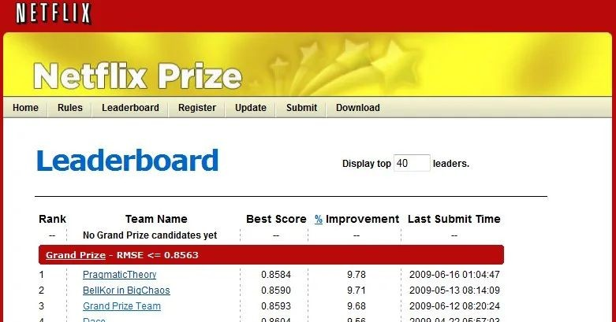

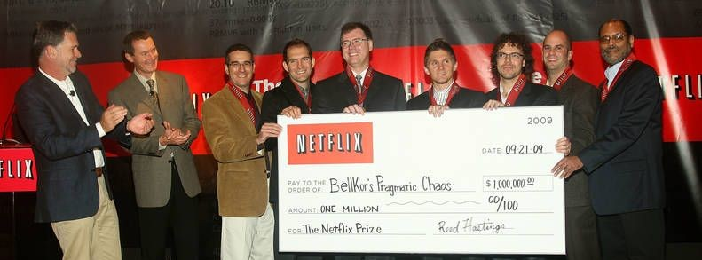
Yehuda Koren

